Slide 1
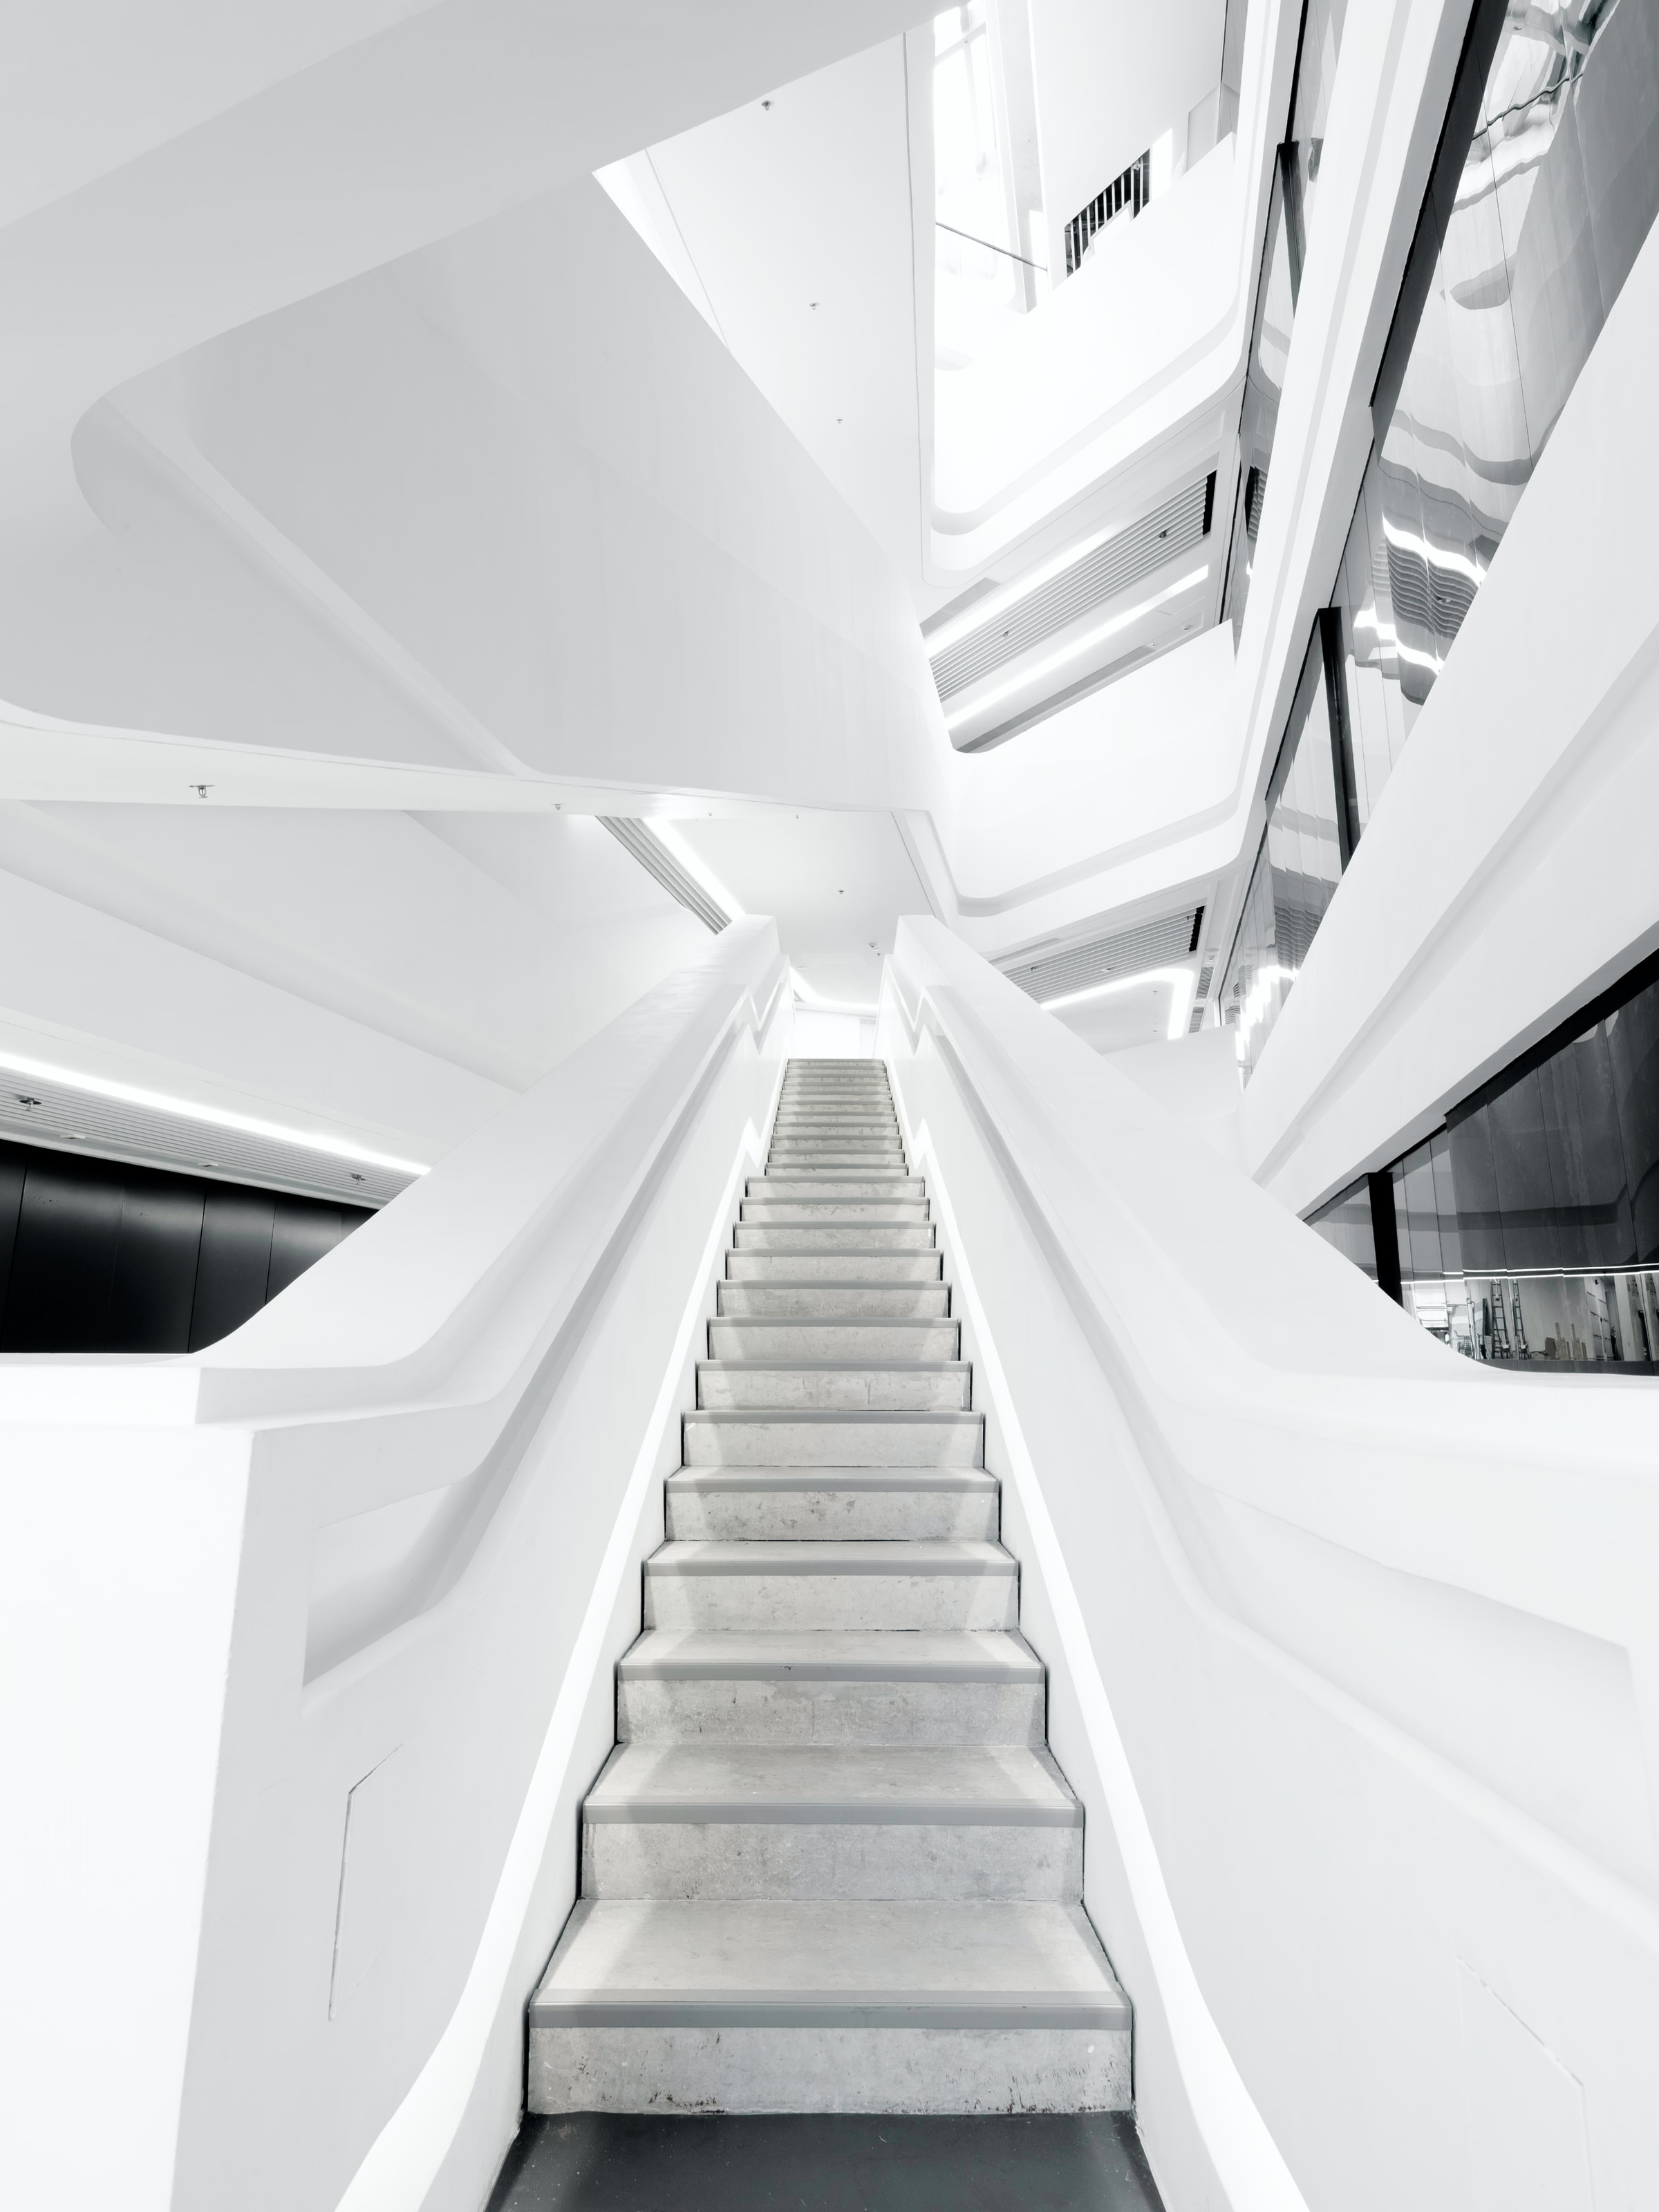
Autodesk University
EXPLORING TECHNOLOGY TRENDs
in thousands of scraped presentations since 2011

Slide 2
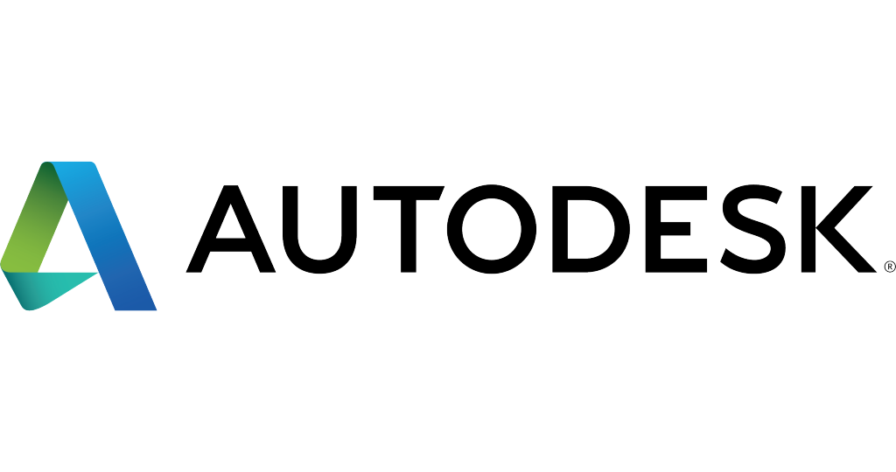





Autodesk, Inc. is an American multinational software corporation. The company became best known for AutoCAD, but now develops a broad range of software and services for various industries:
architecture
engineering
construction
manufacturing
media
education
entertainment
Autodesk software has been used in many fields, and on projects from the One World Trade Center to Tesla electric cars.

Slide 3
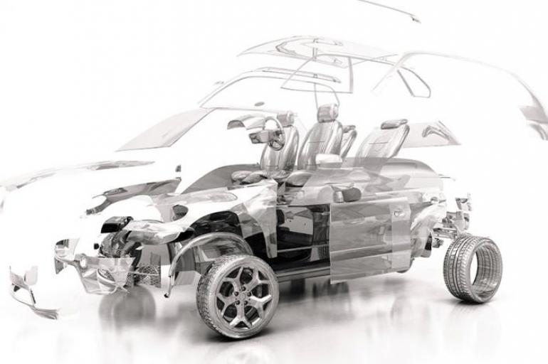
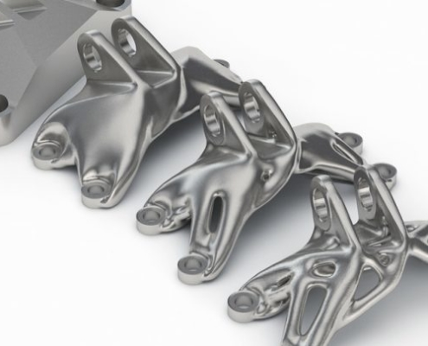
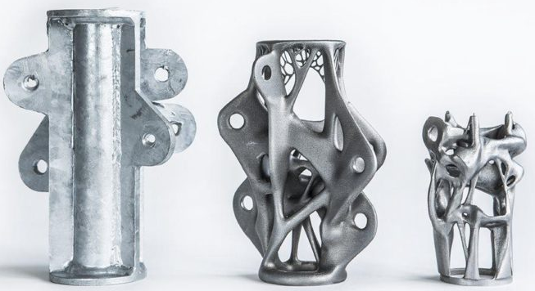
Manufacturing
The manufacturing industry uses Autodesk's digital prototyping software—including Autodesk Inventor, Fusion 360, and the Autodesk Product Design Suite — to visualize, simulate, and analyze real-world performance using a digital model in the design process.

Slide 4
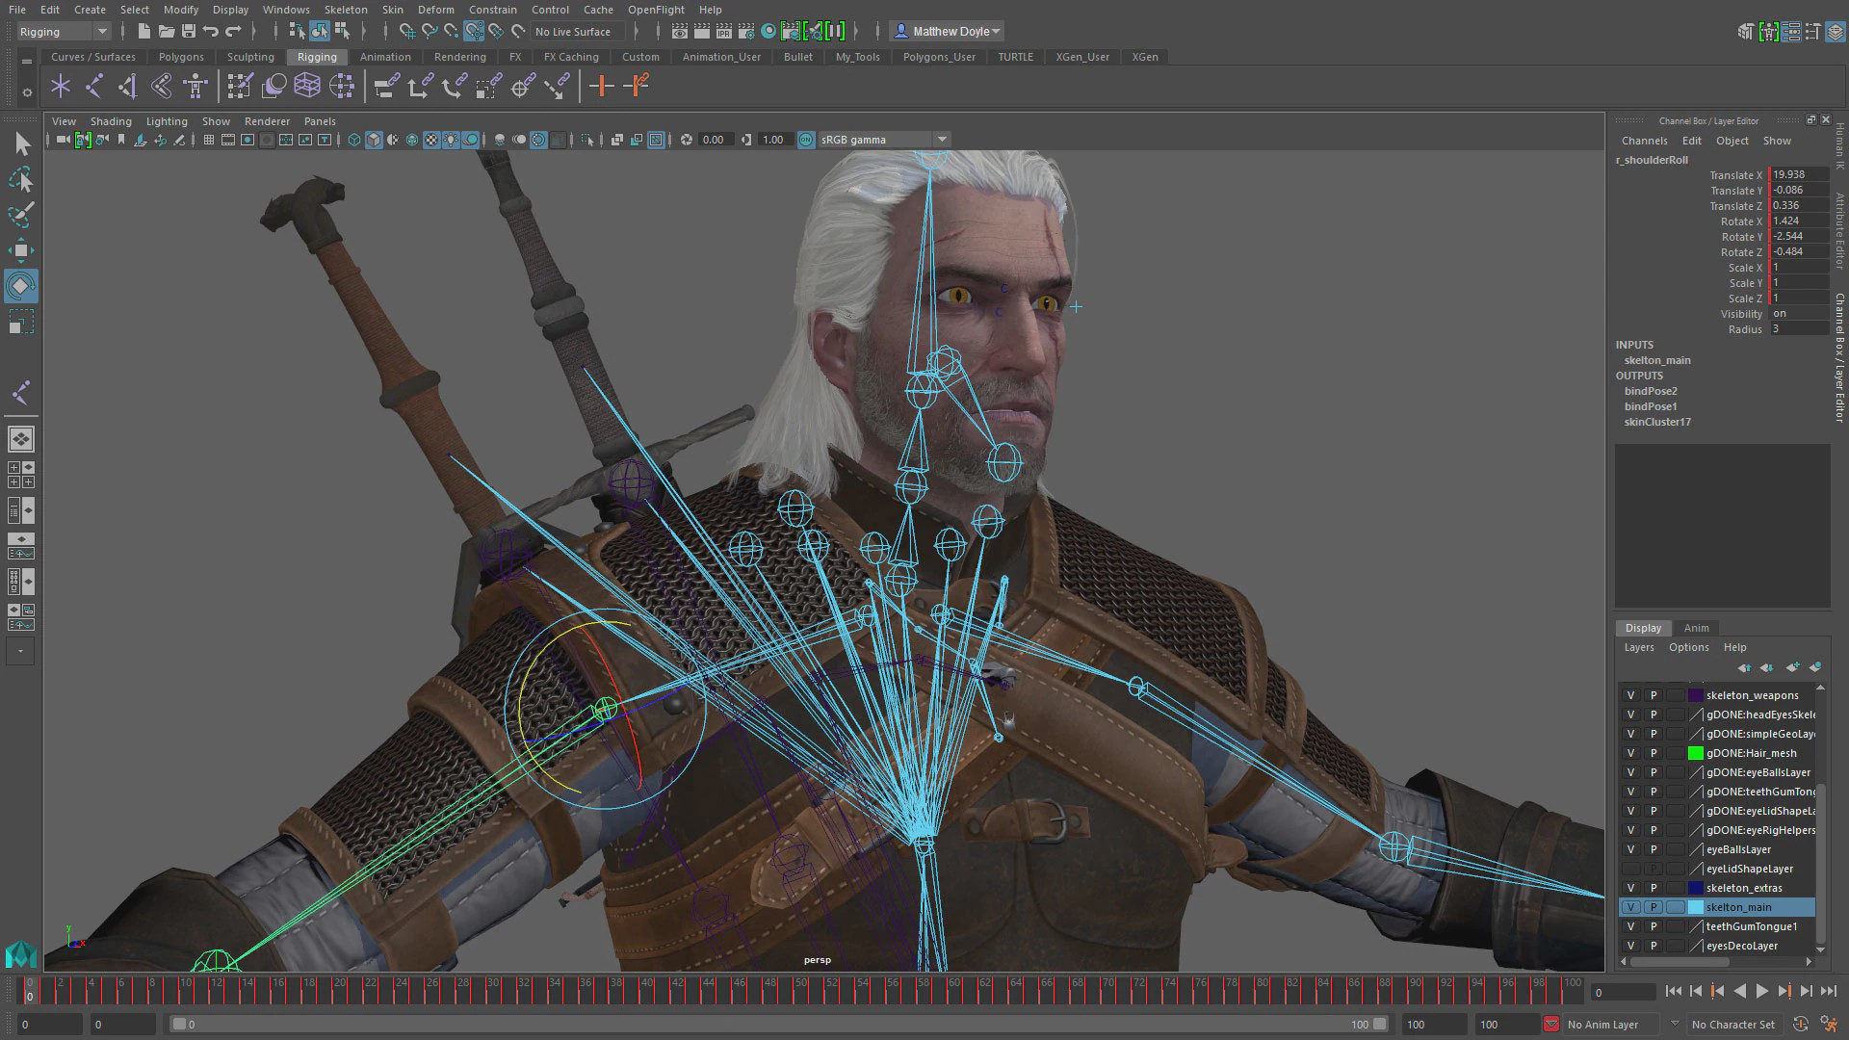
Media & Entertainment
Autodesk's Media and Entertainment division creates software for visual effects, color grading, and editing as well as animation, game development, and design visualization. 3ds Max and Maya are both 3D animation software used in film visual effects and game development.

Slide 5
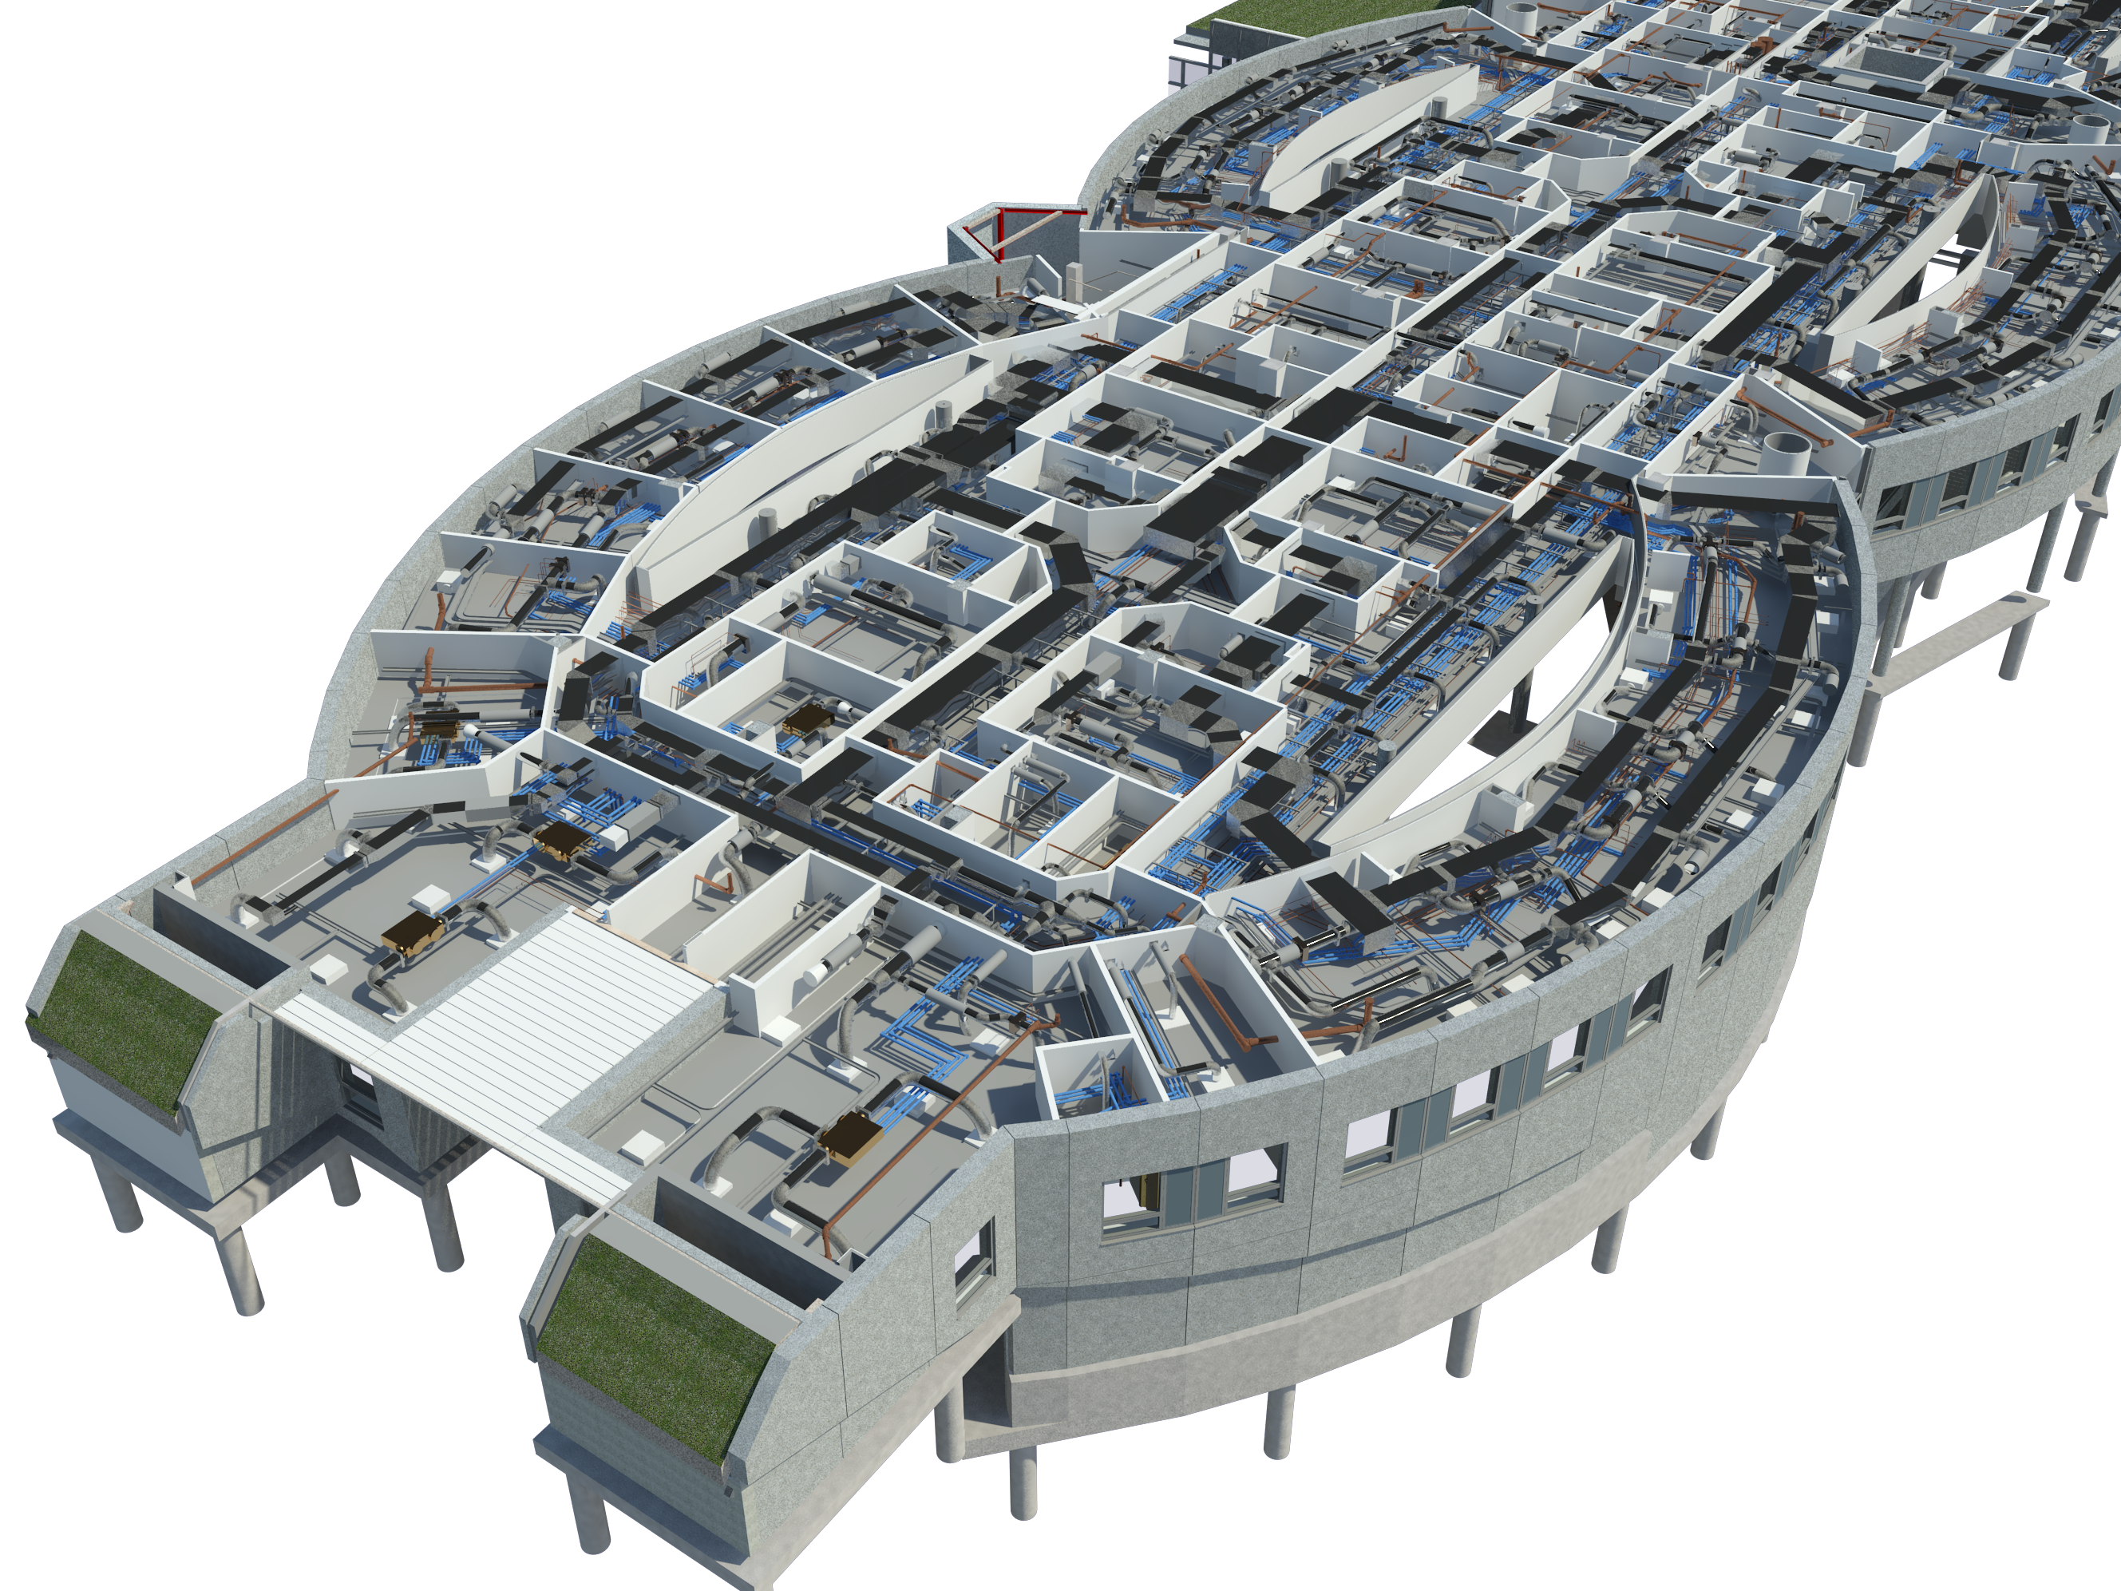
Building Information Modeling
The company's Revit line of software for Building Information Modeling is designed to let users explore the planning, construction, and management of a building virtually before it is built.
BIM is data-driven building design, as the software allows to accumulate all project data, from materials that the walls are made of, to construction planning information.

Slide 6
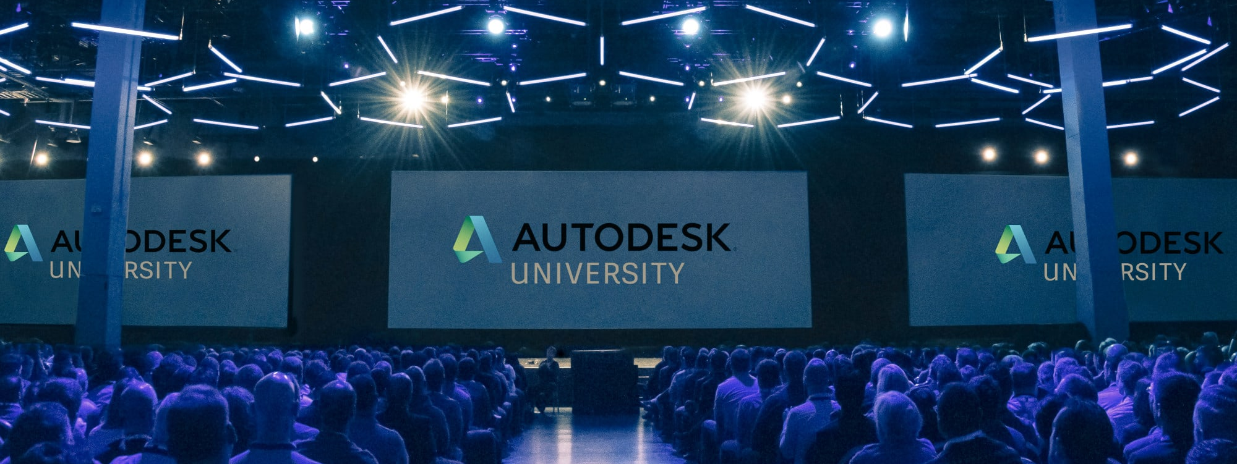
Autodesk University
Autodesk University is a conference that brings together thousands of innovators from around the world every year to explore new ways of imagining, designing, and making.

Slide 7
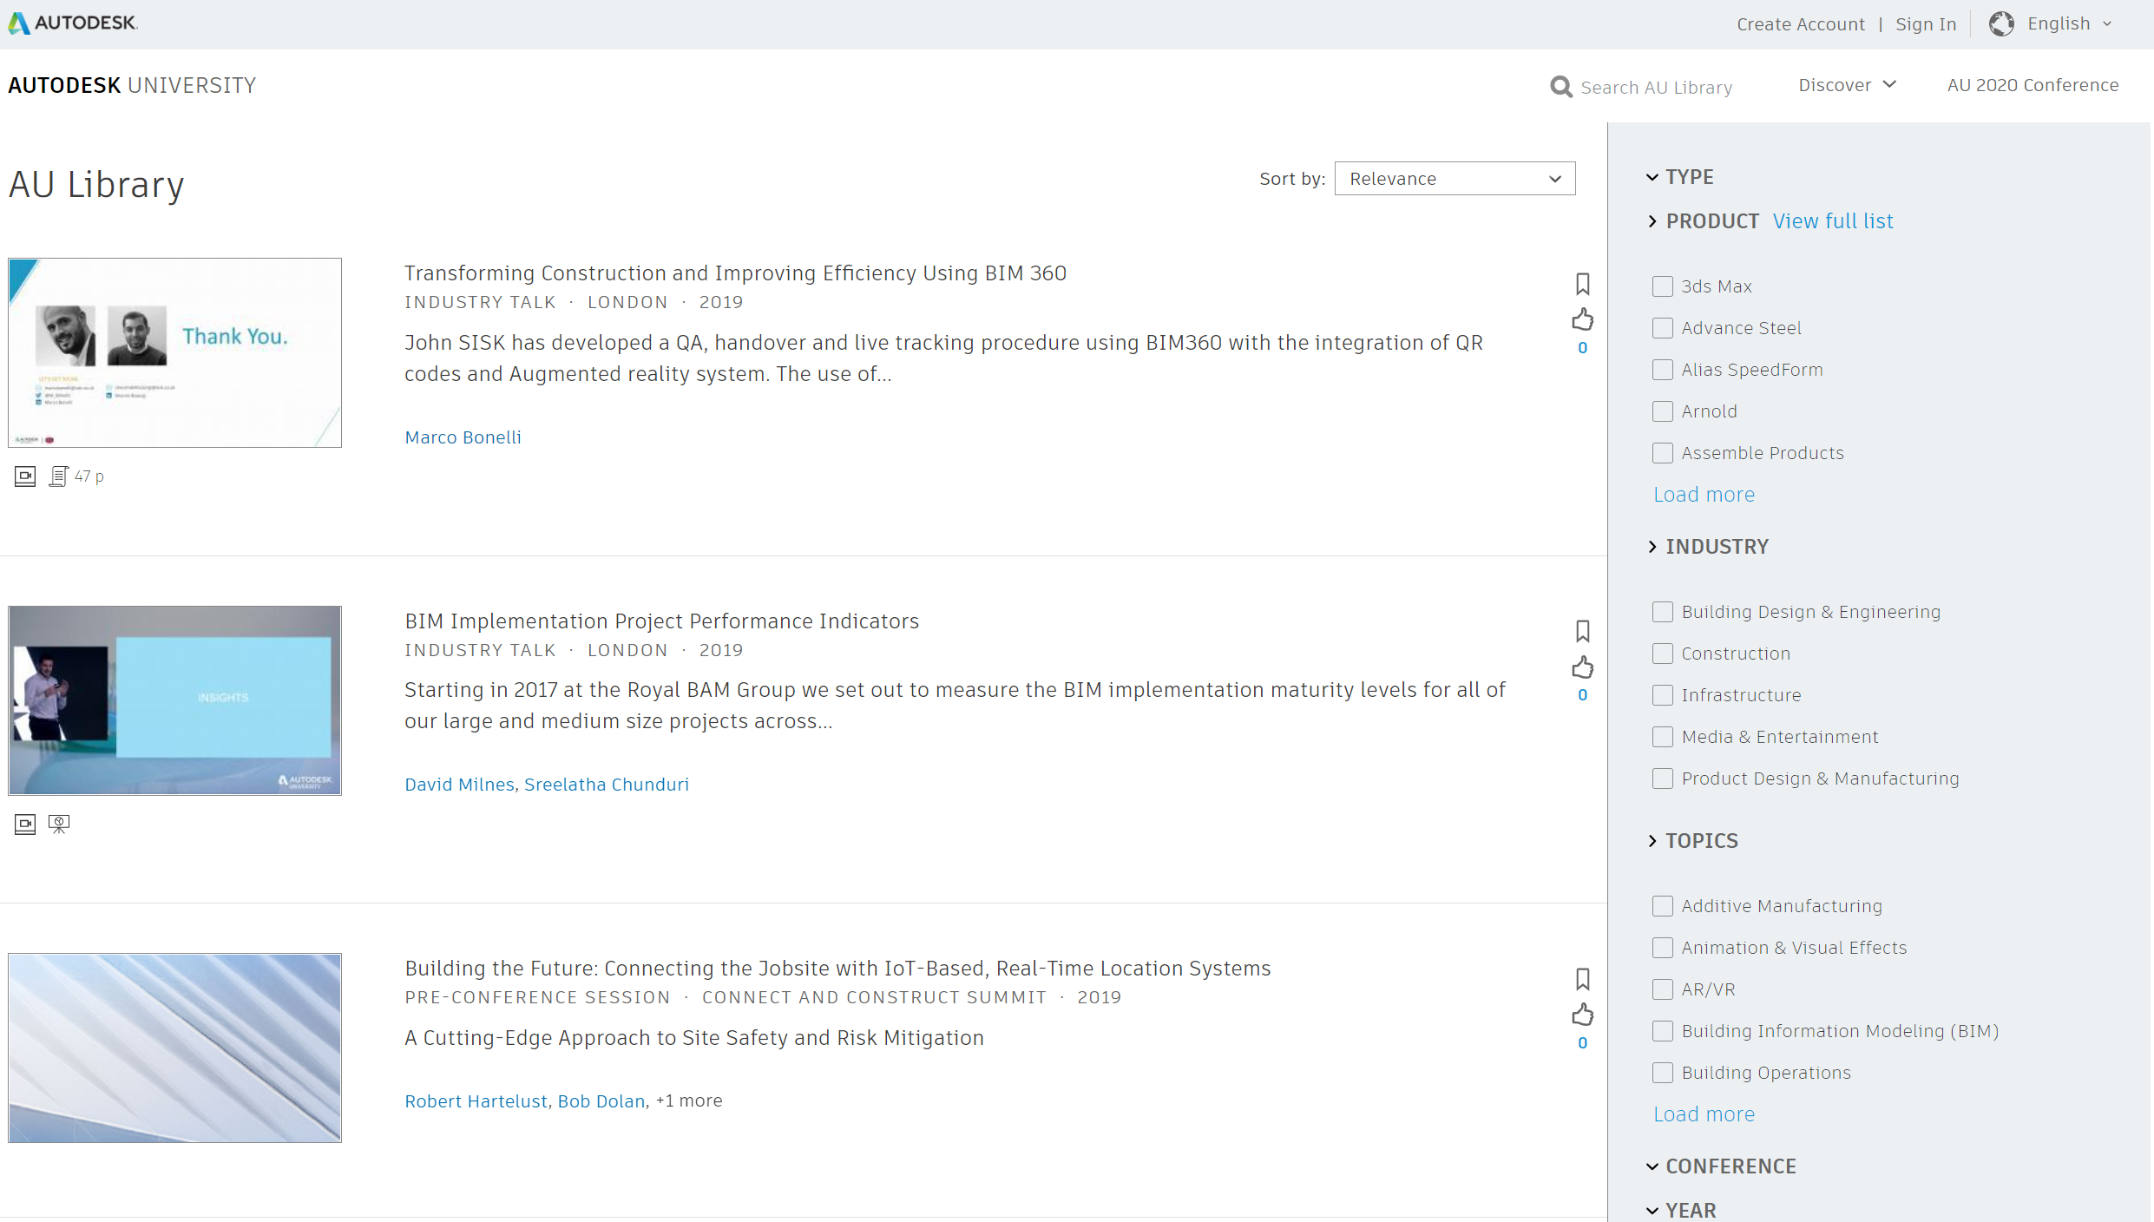
Website https://www.autodesk.com/autodesk-university/au-online

Slide 8
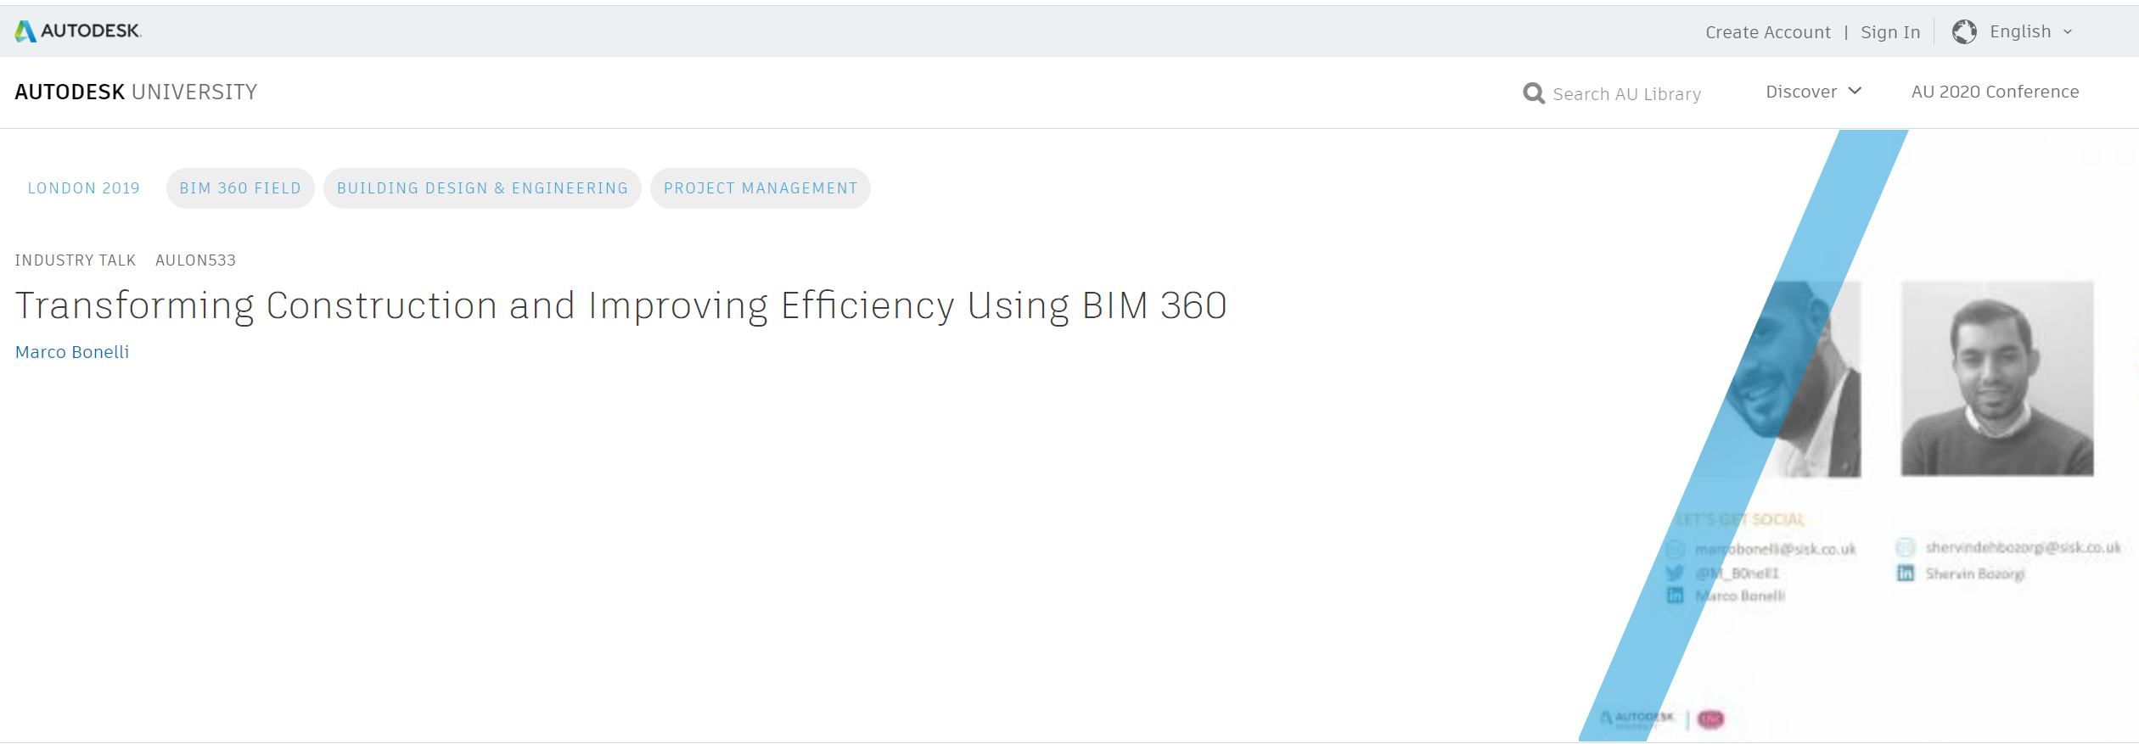
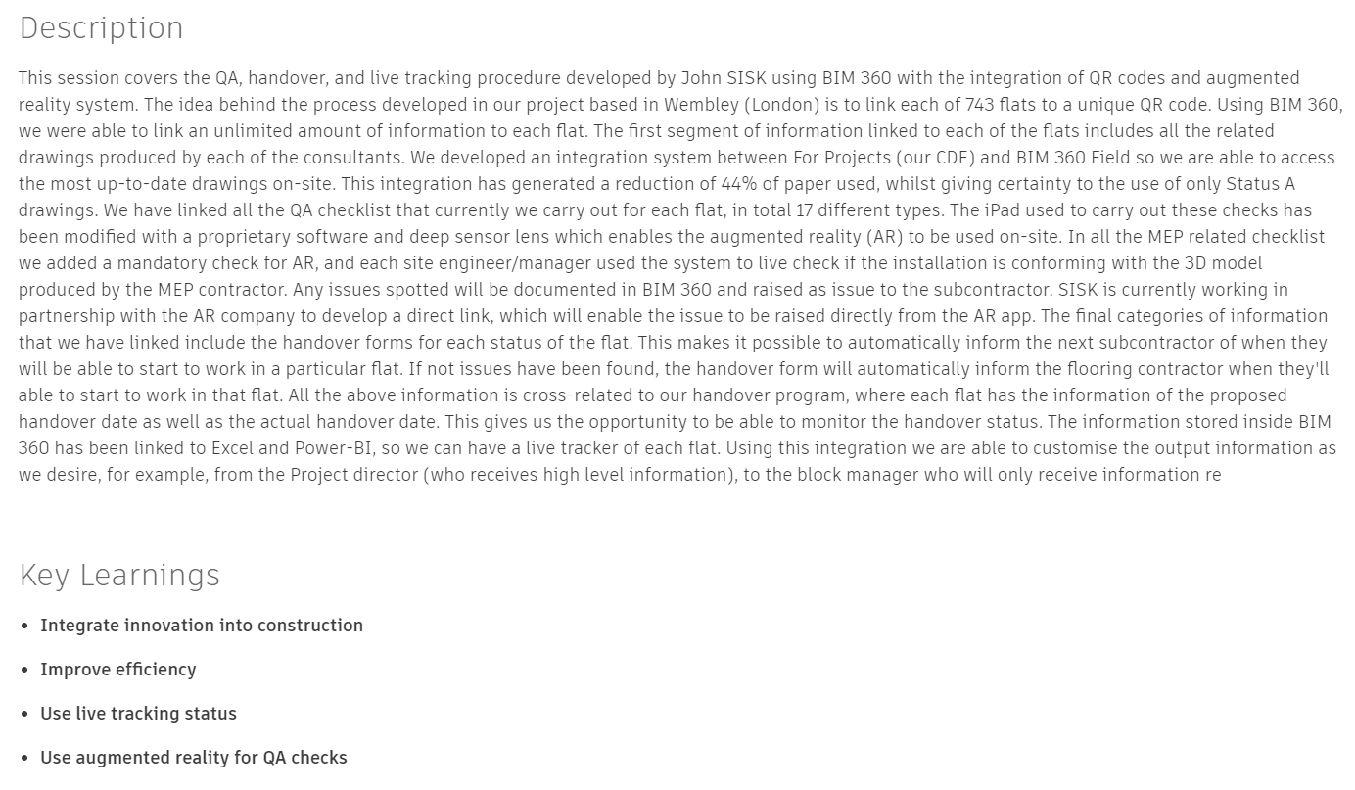
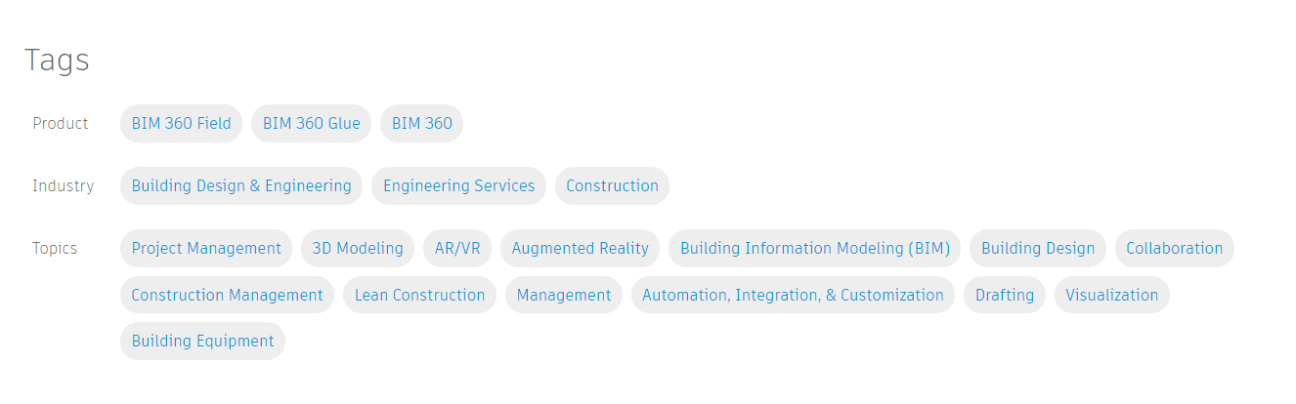
Website https://www.autodesk.com/autodesk-university/au-online
I also searched for programming languages mentioned in the Description to get the insights about software development situation
I used mostly tags for my analysis since they were so carefully applied to every presentation.

Slide 9
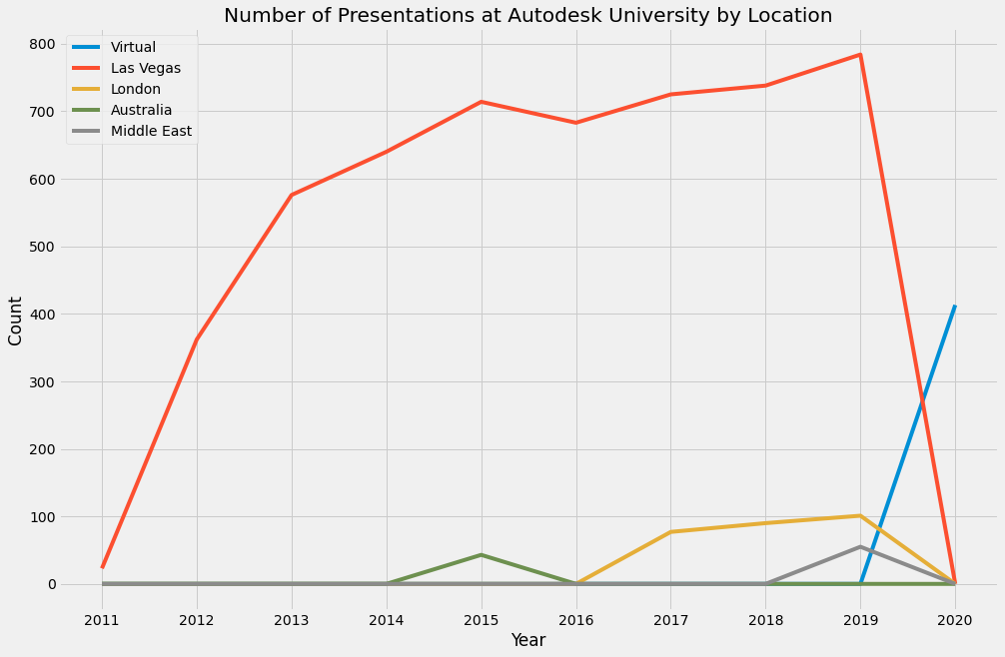
Event Geography
The conference has more locations such as Russia, Japan, Korea, China, South Africa, but the presentations from them are not introduced on the website.
First, the main event is hosted in Las Vegas and usually takes 4 days.
The graph shows the significant growth of the event over the past 9 years, as Autodesk was actively developing and promoting their products and AU itself.

Slide 10
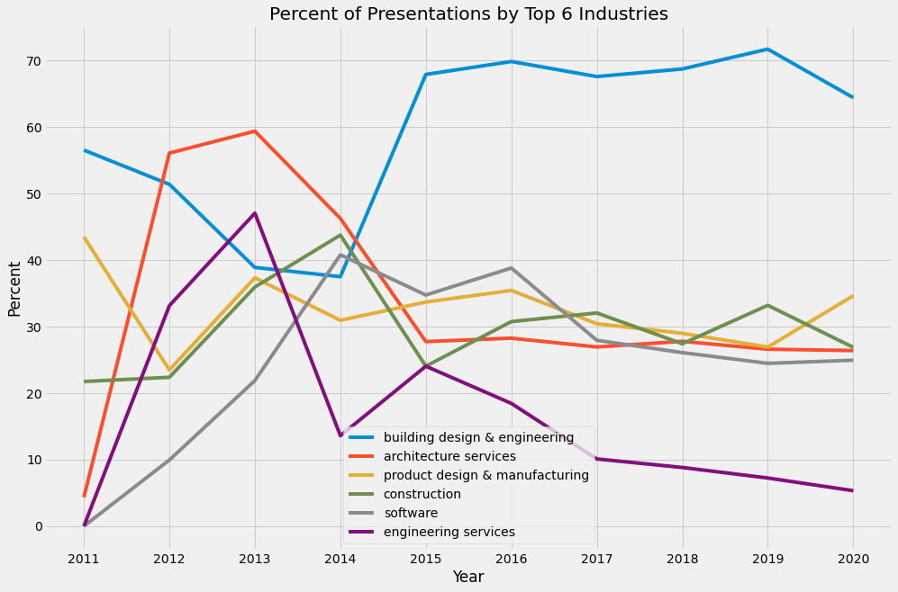
Most Featured Industries
To become a speaker at AU, one must submit an application and gain approval. Autodesk decides which industries and technologies to feature at the conference. Hence, the application and selection process might affect the overall distribution.
It’s my belief that the interests of the consumers should be the main driving factor.
The list of introduced industries was quite large so I reduced them to six most popular.

Slide 11
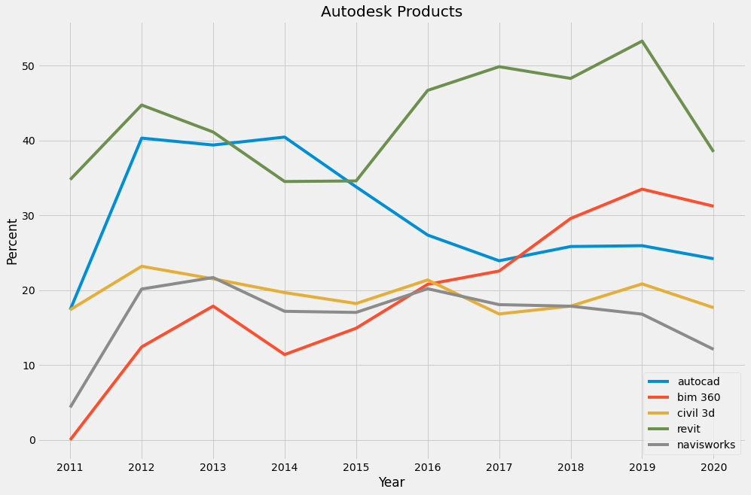
Design Products
I’ve been in the Building Design Industry for over 10 years and witnessed many changes and trends from the inside.
Over these 10 years the industry made huge steps from 2D blueprints (AutoCAD) to creating a virtual copies of buildings long before there're built and aggregating data in the models (Revit, BIM 360, Navisworks).
I was curious to know what will my data show, will it confirm my hypothesis?

Slide 12
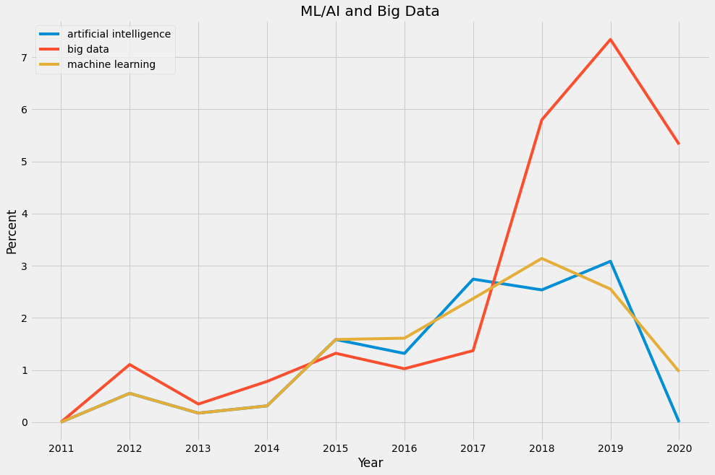
ML/AI and Big Data
Many industries now realize how beneficial the use of Machine Learning and AI is. BIM is not an exception, since it’s data driven.
ML and AI are already used to solve various problems, such as classifying construction damage by image or monitoring safety at a building site using Neural Networks.
Quick industry growth and the perspective of creating digital cities should bring the use of ML/AI to the whole new level

Slide 13
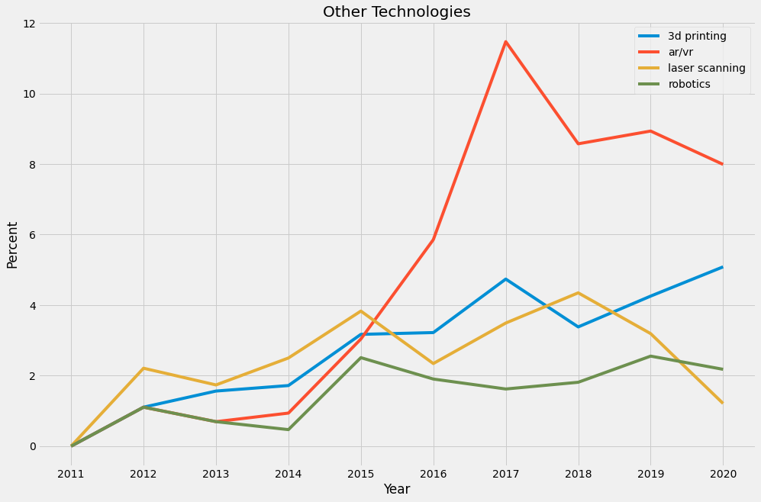
Other Technologies
Everyone saw little 3D printed toys and building copies, but did you know that a whole building can be 3D printed nowadays?
With laser scanning we can get virtual point clouds that are used to recreate existing buildings in 3D.
AR and VR make it possible to walk around a building that doesn’t yet exist or visualize MEP systems on site before they are installed.
Robots are now able to conduct routine inspection tasks and capture data from a building site safely and accurately.

Slide 14
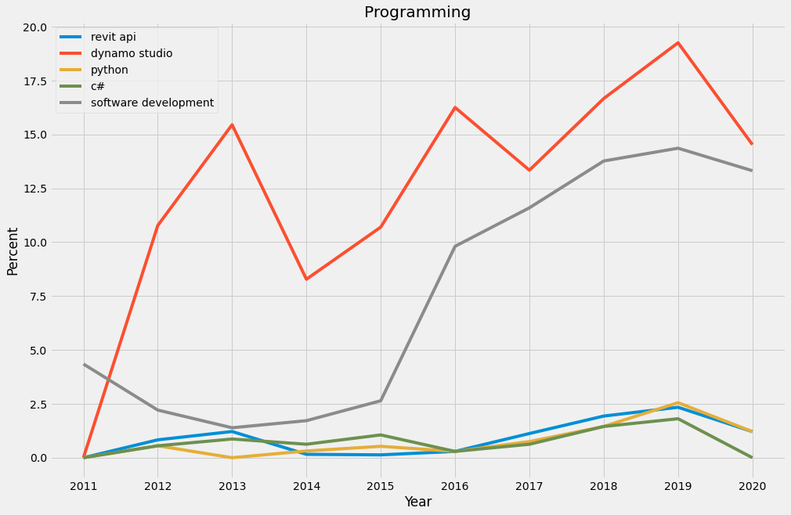
Software Development
Standard software functionality is never enough, there’s always a need to automate routine tasks such as documentation production, data aggregating, export and analysis.
Autodesk products have open API’s that provide limitless possibilities for creating the additional tools that every particular design team requires.

Slide 15
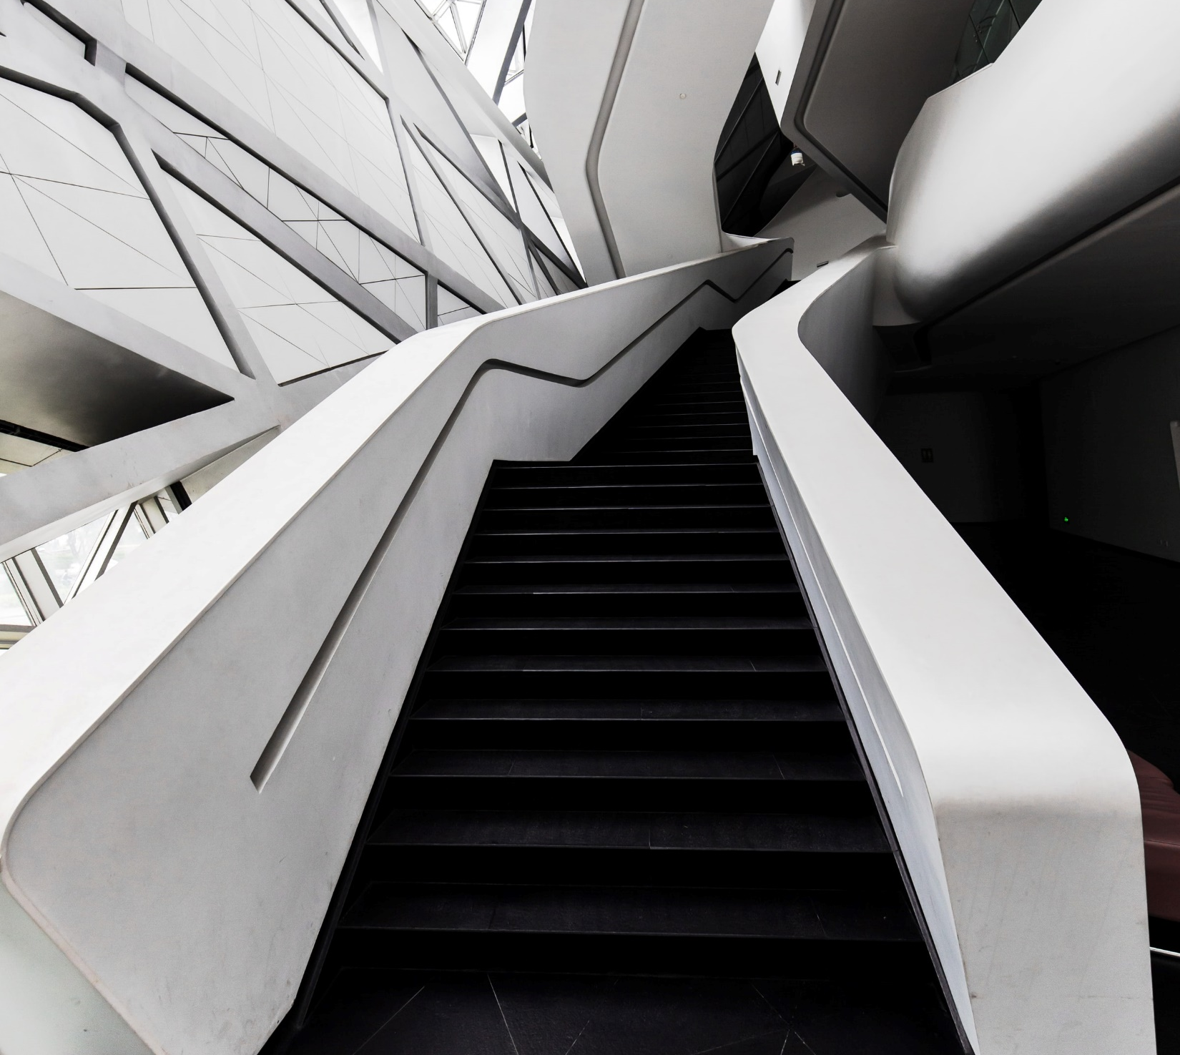
Conclusion
The world of Technology evolves rapidly, constantly bringing new tools to every industry.
Knowledge of the trends, available tools and services can help companies in the construction industry determine how to reduce costs of design, building and maintenance. Optimized workflows lead to improved results.
The data I managed to collect is not as rich as I expected, exploring presentations from Autodesk events all over the world could bring much more interesting insights.
However, the trends shown in the data confirm my perceptions, based on what I’ve had based on 10 years of experience in the industry and visiting Autodesk University in Russia each year.

